Slide 1
World Happiness
By: Mohammed Al Saleem 188301

Slide 2
Table of Contents
Introduction
Data Description
The Scientific Goals
Exploring data (Regions and Years)
Multi-Collinearity
Multiple Linear Regression
Logistic Regression (AIC, ROC, and Confusion Matrix)
﻿Discussion

Slide 3
INTRODUCTION
Happiness is not just a good feeling and a smiley face. It is the feeling of enjoying life and satisfaction, and the desire to make the best of your life. Happiness is what make us be and do our best.
Our happiness is under our control. Researches and psychologists found that happiness mainly depends on our mindset, our habits, and our way of live. So, everyone can be happy if he/she decide!
But the outer world can affect happiness, so we can try to predict it.

Slide 4

INTRODUCTION: Data Description
The world happiness dataset contain data of 146 countries to 158 countries, from 2015 to 2022. The dataset is taken from Kaggle.com
The world happiness report calculated the happiness score from variance sources, like national surveys of the main life evaluation questions (i.g. 10 for the best possible life, and 0 for the worst), GDP (Gross domestic product) per capita for economy.
$$GDP per capita=\frac{\text{Real} \text{GDP} \text{of} \text{the} \text{country}}{\text{Population} \text{of} \text{the} \text{country}}$$
Notes:
2021: 149

Slide 5
INTRODUCTION: Data Description
Attributes (variables):
Economy: Logged GDP per capita
Health: Life Expectancy
Family: Social support (from 0 to 1)
Freedom: to make life choices (from 0 to 1)
Trust: Corruption Perception (from 0 to 1)
Generosity (from -1 to 1)
Happiness Score (0 to 10)
Happy (0,1)
Notes:
Life Expectancy: based on study that use historical data along with the previous survey.

Slide 6
INTRODUCTION: The scientific goals
Explore the dataset across the years and regions, and if COVID-19 left an effect on world's happiness.
investigate the collinearity between factors.
Create a model from year 2021 data.
Simple prediction for happy and not-happy countries (logistic regression).

Slide 7
Exploring data
﻿ Top countries happiness scores:
Year 2015: 1- Switzerland 7.587, 2- Iceland 7.561
Year 2016: 1- Denmark 7.526, 2- Switzerland 7.509
Year 2017: 1- Norway 7.537, 2- Denmark 7.522
Year 2018: 1- Finland 7.632, 2- Norway 7.594
Year 2019: 1- Finland 7.769, 2- Denmark 7.600
Year 2020: 1- Finland 7.809, 2- Denmark 7.646
Year 2021: 1- Finland 7.842, 2- Denmark 7.620
Year 2022: 1- Finland 7.821, 2- Denmark 7.636

Slide 8
Exploring data
﻿ Lower countries happiness scores:
Year 2015: 1- Togo 2.839, 2- Burundi 2.905,
Year 2016: 1- Burundi 2.905, 2- Syria 3.069,
Year 2017: 1- Central African 2.693, 2- Burundi 2.905,
Year 2018: 1- Burundi 2.905, 2- Central African 3.083,
Year 2019: 1- South Sudan 2.853, 2- Central African 3.083,
Year 2020: 1- Afghanistan 2.567, 2- South Sudan 2.817,
Year 2021: 1- Afghanistan 2.523, 2- Zimbabwe 3.145,
Year 2022: 1- Afghanistan 2.404, 2- Lebanon 2.955,

Slide 9
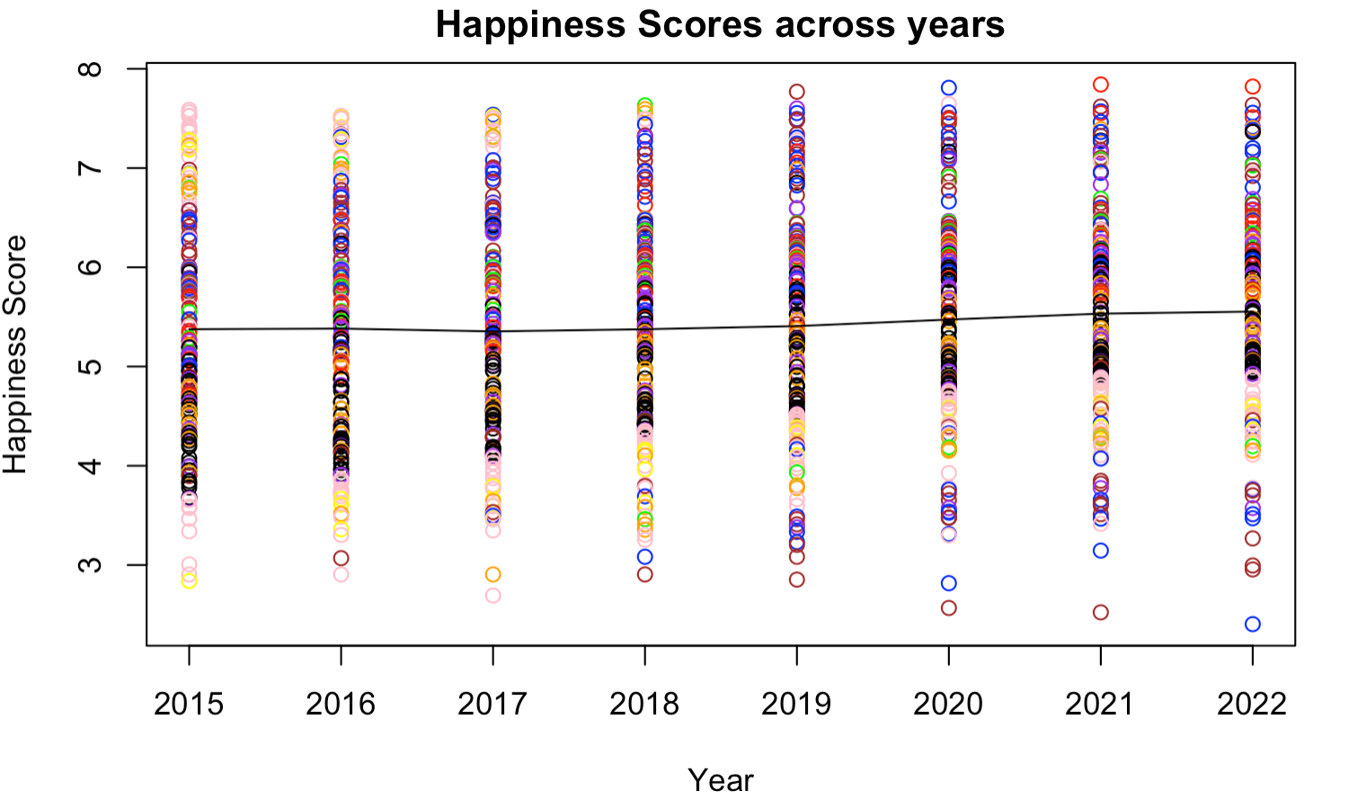
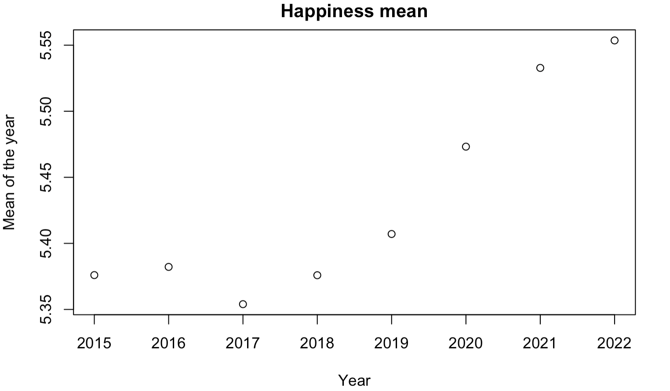
Exploring data

Slide 10
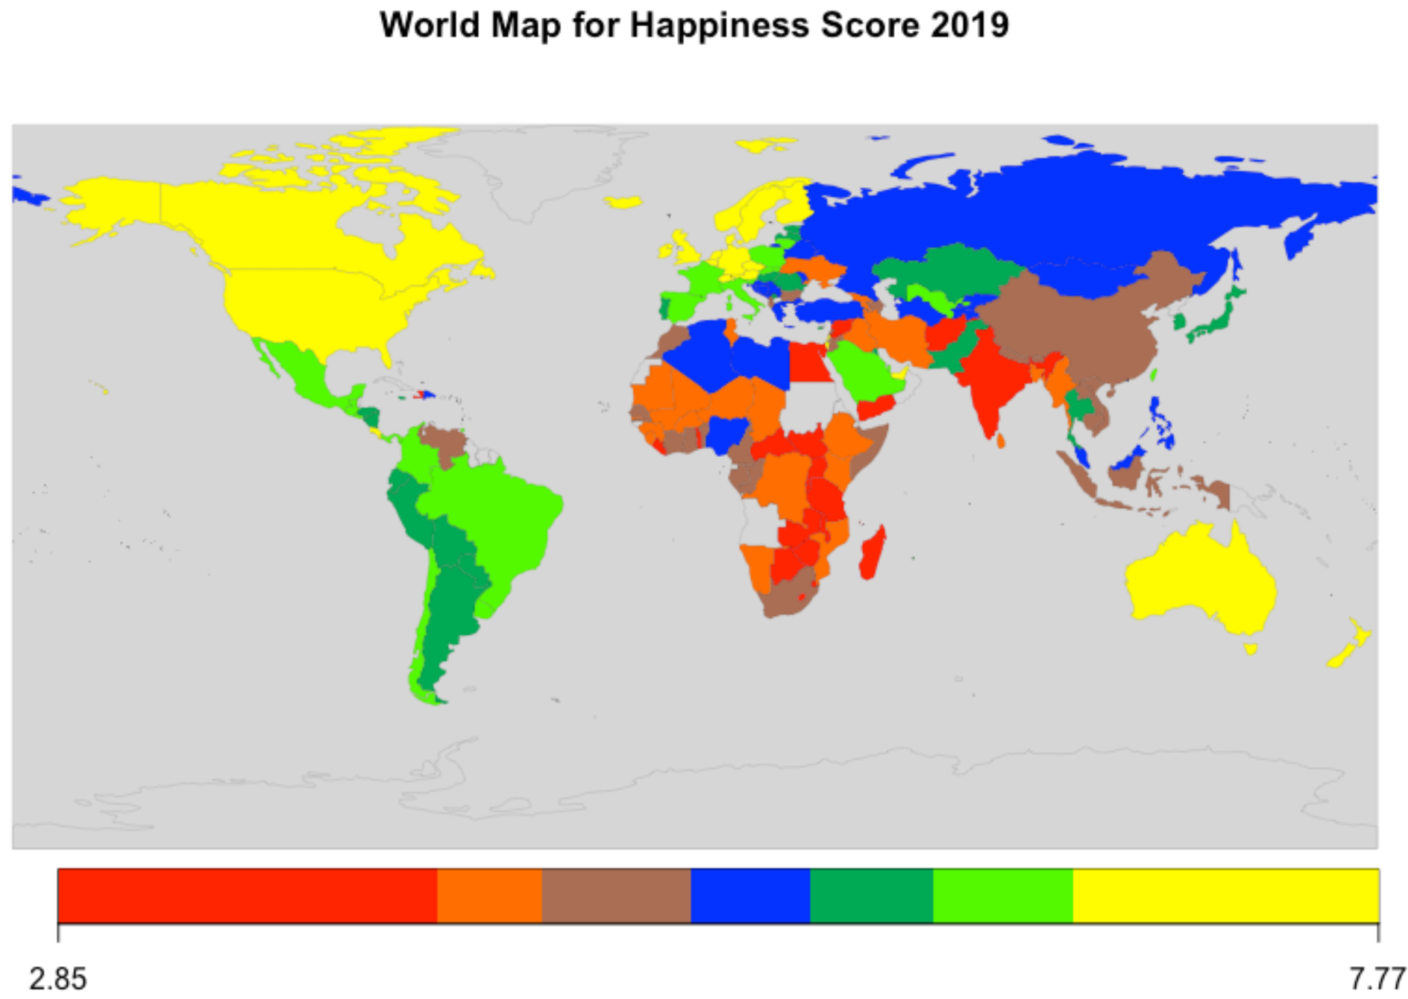
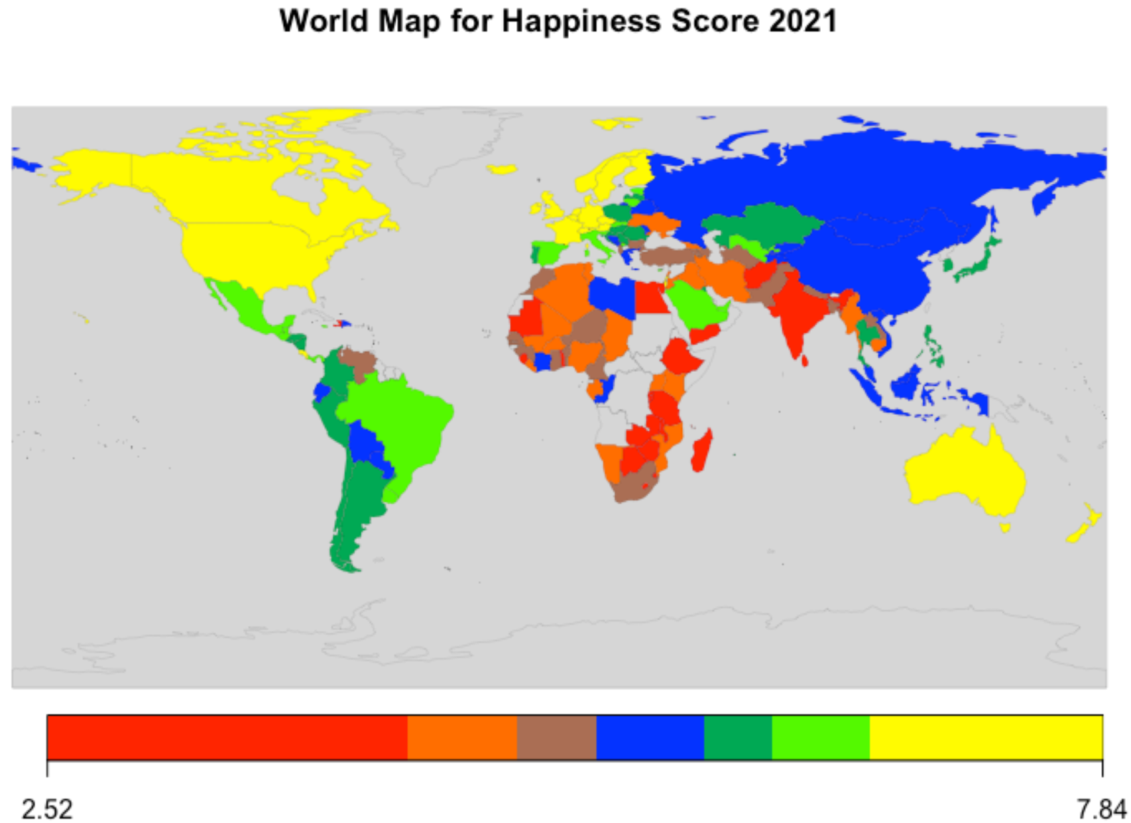
Exploring data
Notes:
There is no sign that COVID-19 left an effect on world's happiness.

Slide 11
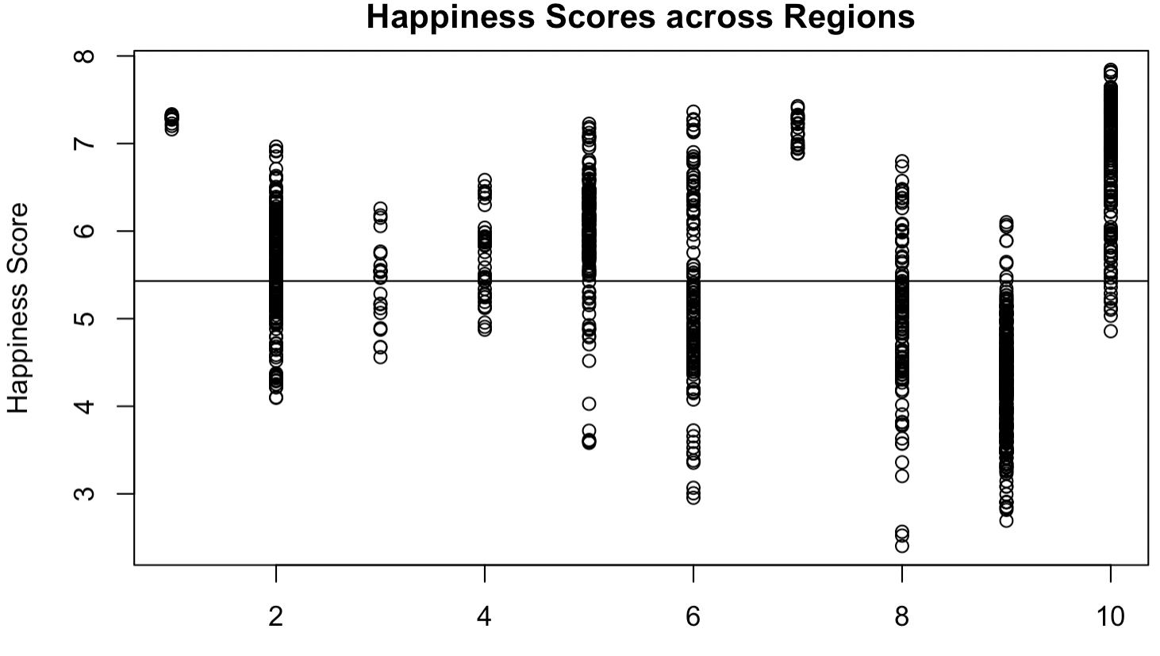

Exploring data
﻿[1] Australia and New Zealand [2] Central and Eastern Europe
[3] Commonwealth of Independent States [4] East Asia
[5] Latin America and Caribbean [6] Middle East and North Africa
[7] North America [8] South Asia
[9] Sub-Saharan Africa [10] Western Europe
Notes:
Regions will be added to the model to test if their effect is significant.

Slide 12

Multi-Collinearity
Multicollinearity happens when the regressors linearly dependent.
Multicollinearity is a problem where having highly correlated independent variables cause significant fluctuate in the model results if one of the correlated variables changed, which make the model unstable and vary due to any small change.
$$\text{ρ}\text{(}\text{X}\text{,}\text{Y}\text{)}=\frac{\text{cov}\text{(}\text{X}\text{,}\text{Y}\text{)}}{\text{σ}\text{X} \text{σ}\text{Y}}$$
To check multicollinearity, first is to plot the correlation of all the variables. Good function for this is "ggpairs".
The second method is to use VIF (Variance Inflation Factor). It measures the multicollinearity of multiple regression variables in a model.
Notes:
The higher VIF value for variable means higher correlation between it and the rest variables.
The methodology to fix the Multicollinearity issue is to remove one or some variables that have high correlation and VIF.

Slide 13

Multiple Linear Regression
Where the dataset has multiple independent variables, Multiple Linear Regression (MLR) is used to fit a model. ﻿The basic MLR model is:
$$y_{i}=β_{0}+β_{1}x_{1}+…+β_{n}x_{n}+ε_{i}$$
where 𝑦_{𝑖} is the dependent variables, 𝑥₁,…,𝑥_{𝑛} are the independent variables, 𝜀_{𝑖} random error, 𝛽₀,…,𝛽_{𝑛} are the coefficients that will be estimated.
As arrays: $\text{Y}\text{=}\text{β}\text{X}\text{+}\text{ε}$
After fitting the model with all variables, backward stepwise selection will be used to select the final model that have all variables significant.
Notes:
the final model that have all variables significant.

Slide 14
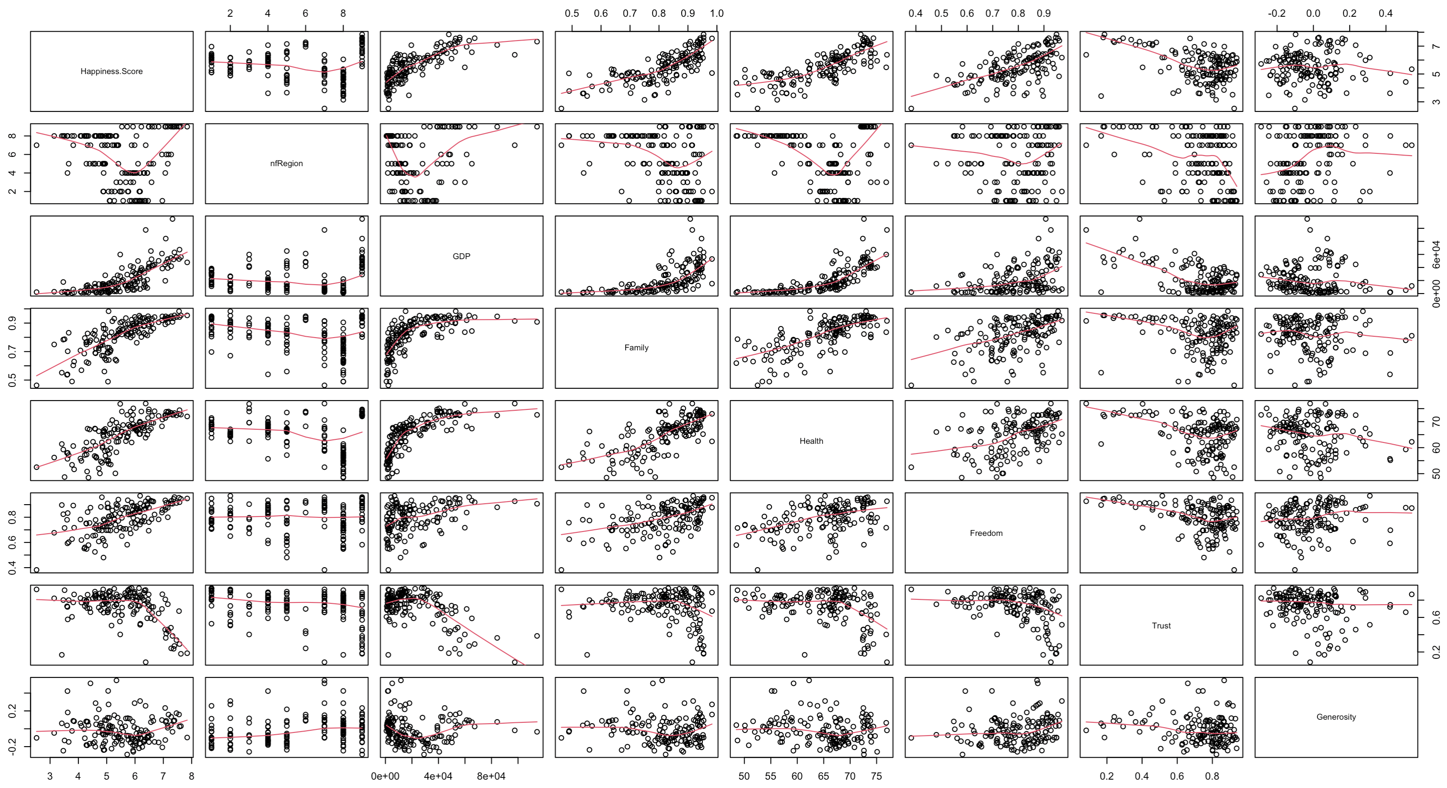
Notes:
We can see GDP need to be transformed by logged (to Economy variable).

Slide 15
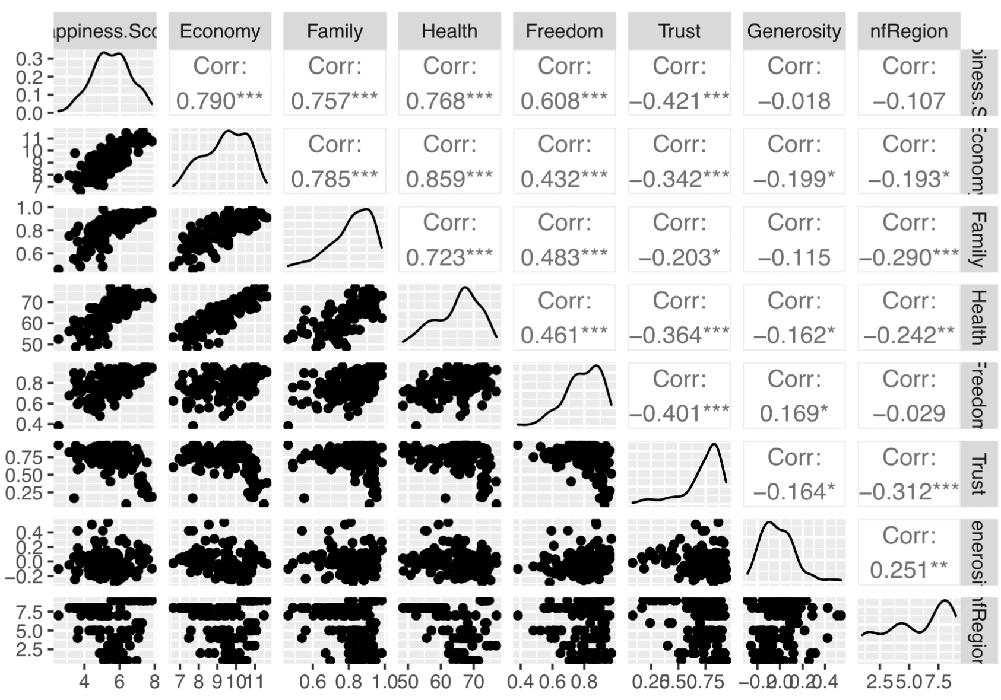
Multi-Collinearity
VIF values of model0: Economy (5.1656), Family (3.0635), Health (4.2707), Freedom (1.5864), Trust (1.5961), Generosity (1.2097), nfRegion (1.3929).
After deleting Economy, VIF of Family and Health decreased to 2.3476 and 2.5395 respectively.

Slide 16

Multiple Linear Regression
For comparing the models adjusted R² is used instead of R².
$$R_{a}^{2}=1−\frac{SSE/(n−p−1)}{SST/(n−1)}$$
For residual analysis, the used methods are diagnostic plots, residual plots, Shapiro test, and non-constant variance test. To test normality, linearity, homogeneity of the variance, and cook’s distance.

Slide 17
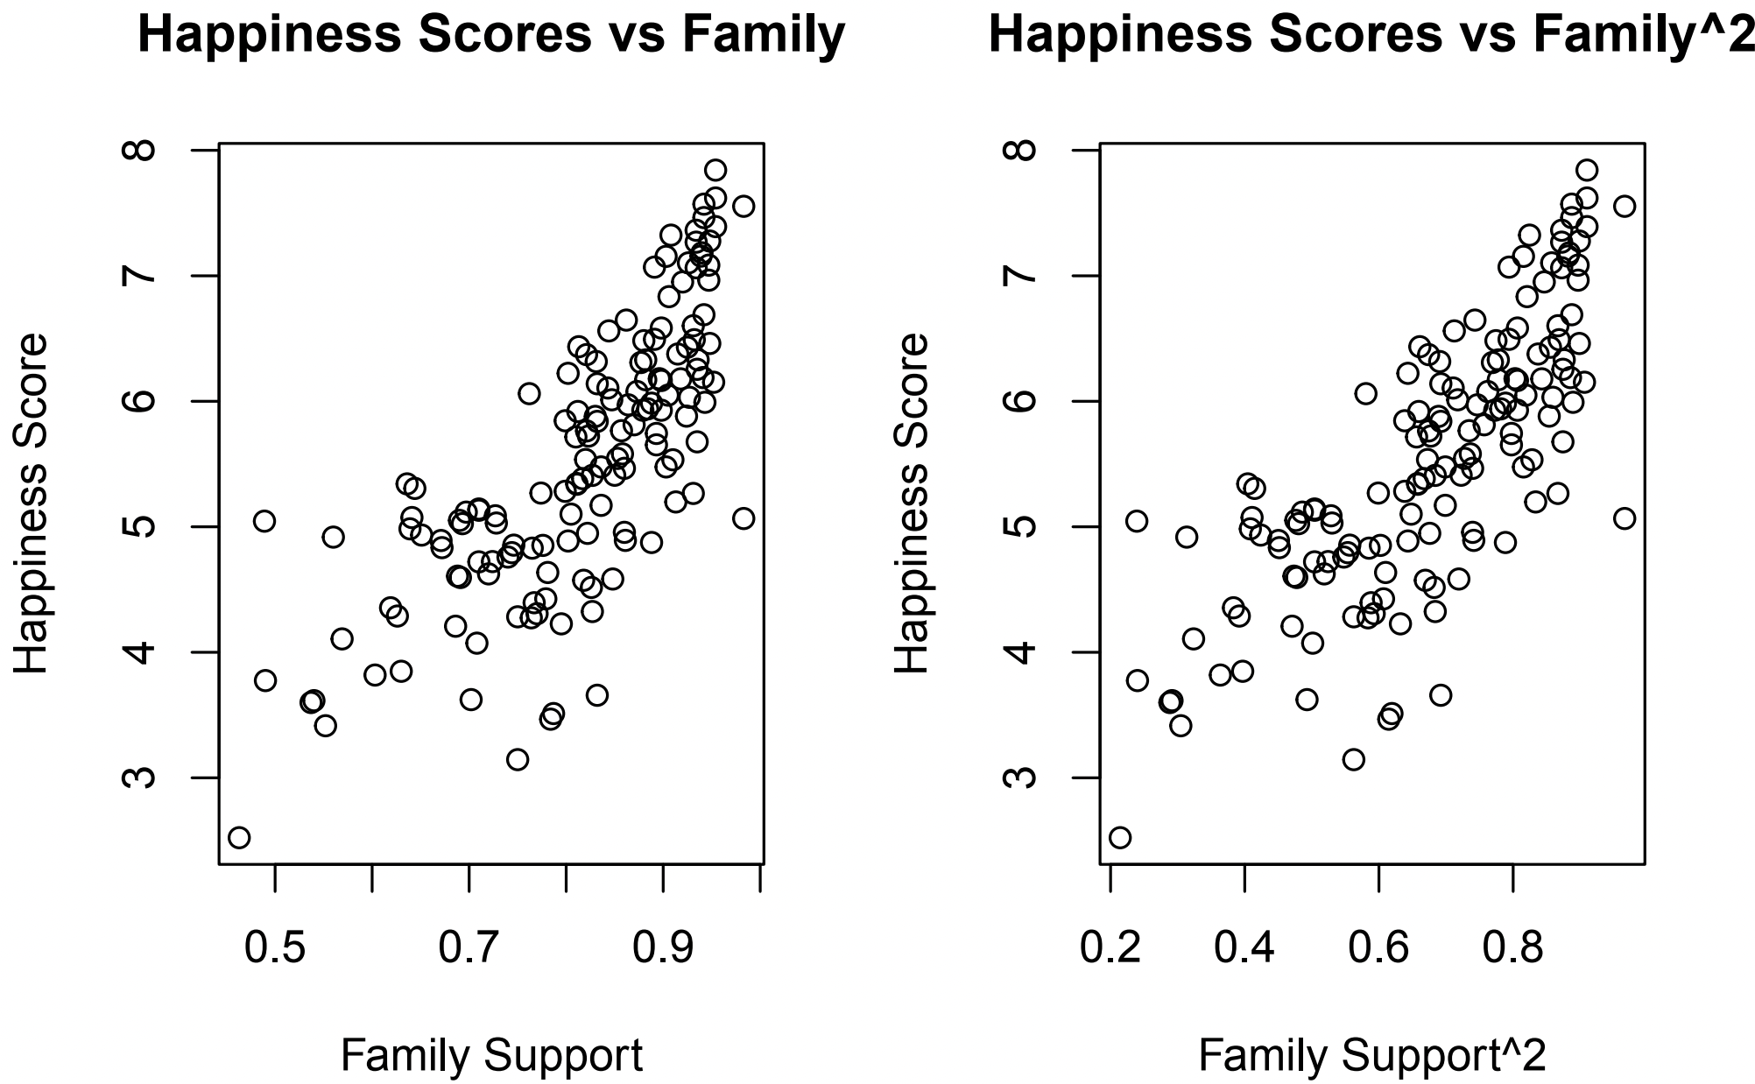
Multiple Linear Regression
The model with family have adj. R² = ﻿0.73025
The model with family² have adj. R² = ﻿﻿0.73653

Slide 18

Multiple Linear Regression
After continue backward selection, the model end with: $Happiness Score=2.5624×{Family}^{2}+0.0467×Health+1.7974×Freedom−0.9048×Trust,$
with adj. R² = 0.9904. While the first model adj. R² = 0.7303
Shapiro-Wilk normality test model0: W = 0.968, p-value = 0.0015
Shapiro-Wilk normality test modelf: W = 0.9746, p-value = 0.0073
Non-constant Variance Score Test model0: Chi-square = 5.1996, p = 0.0226
Non-constant Variance Score Test modelf: Chi-square = 5.5263, p = 0.0187
And for anova(model0, modelf), p = 0.05657
Notes:
Anova fail to reject modelf different than model0, but modelf have fewer variables and all of them are significant, and higher adj.R².

Slide 19
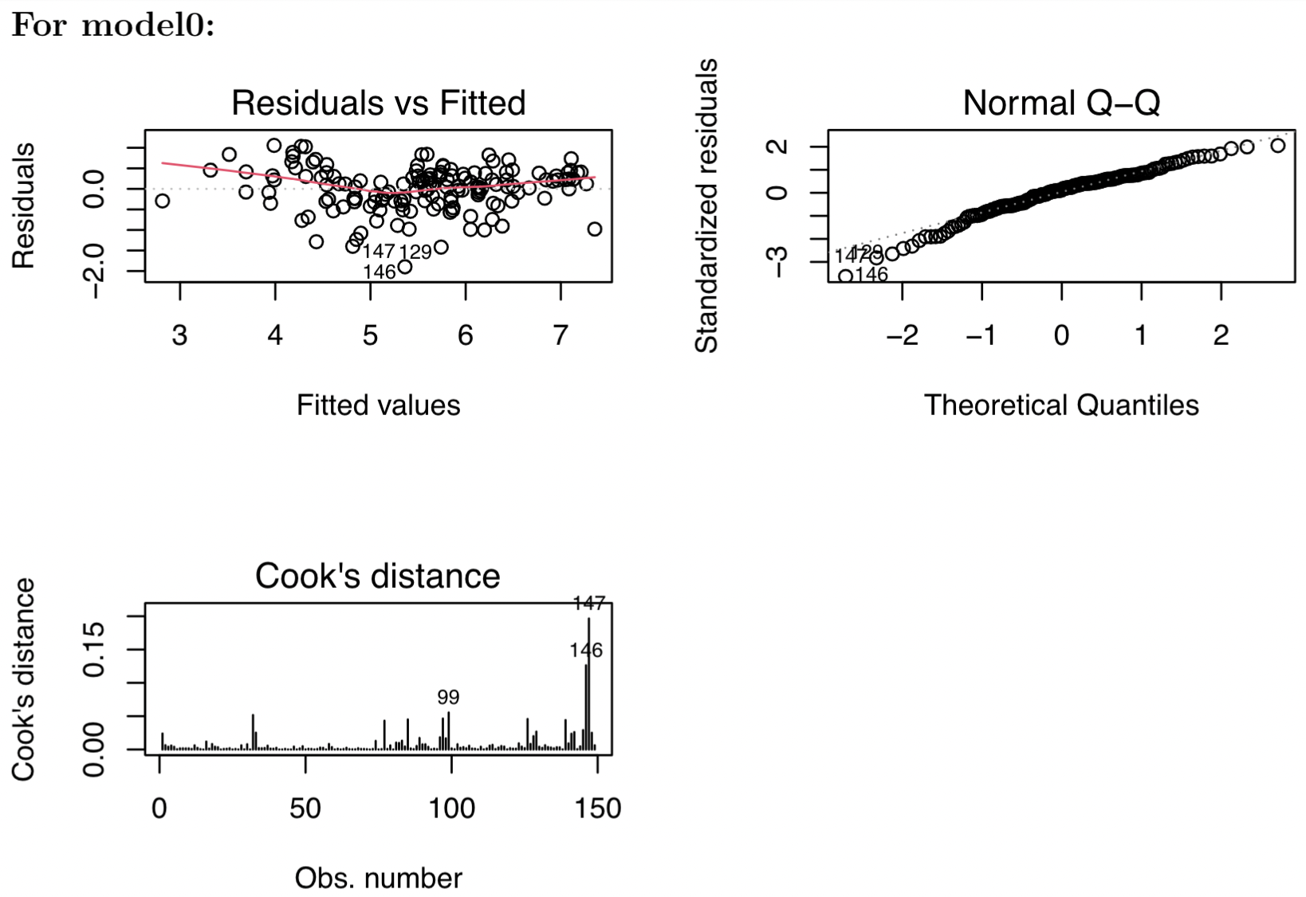
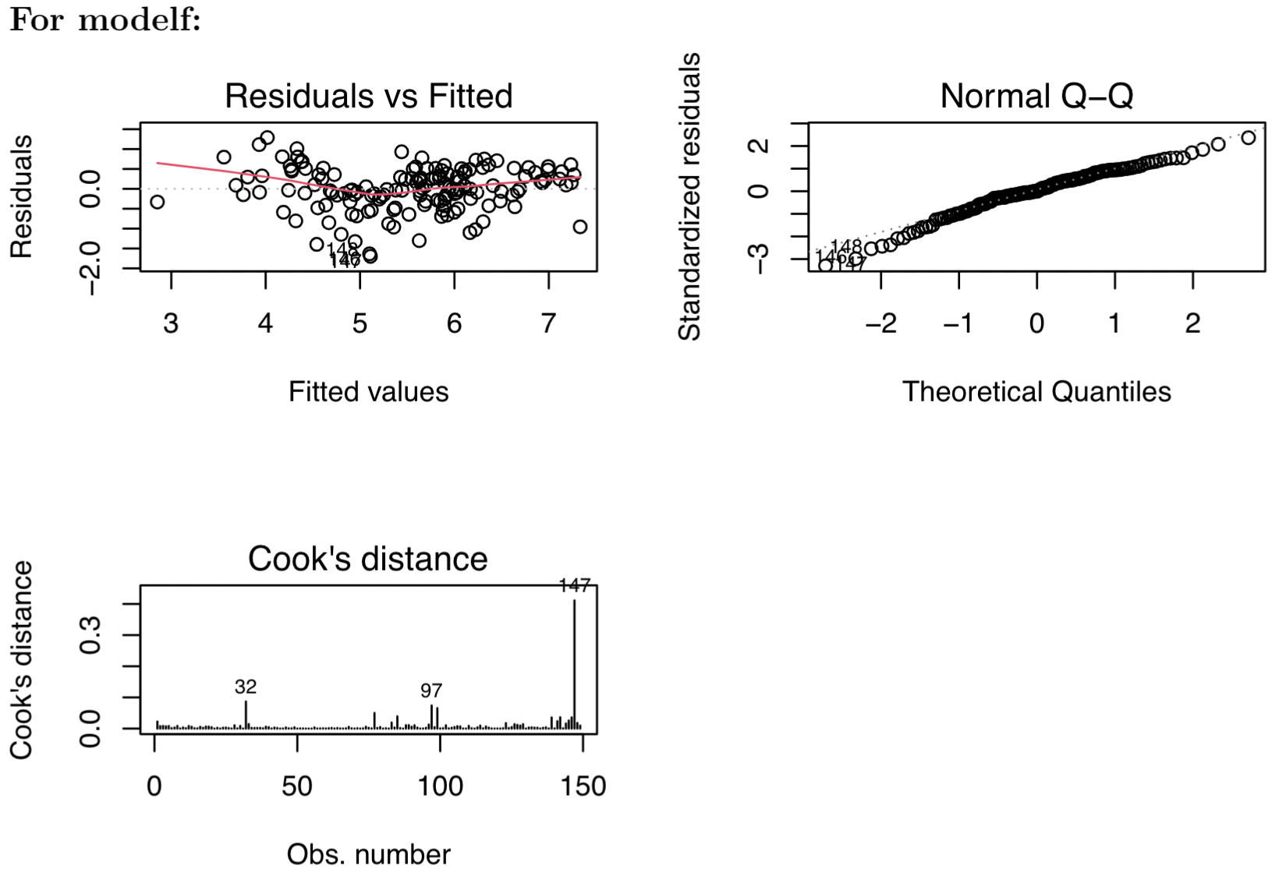
Multiple Linear Regression

Slide 20
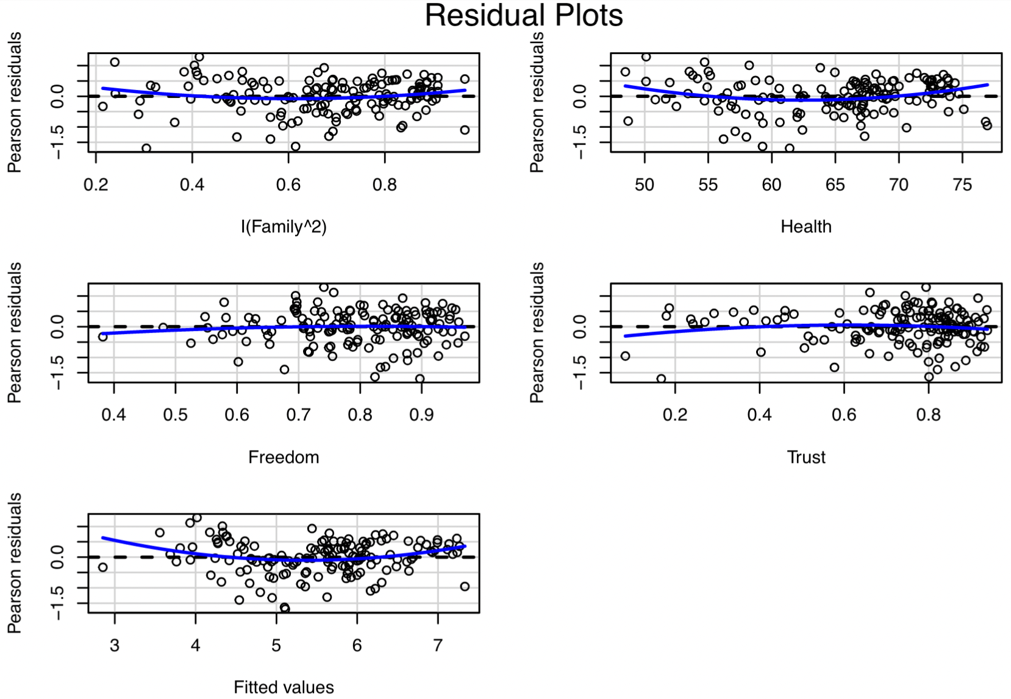
Multiple Linear Regression
Notes:
Residual plots gives acceptable graphs.

Slide 21

Logistic Regression
Classifying countries to happy and not-happy. To do this we need to use logistic regression.
Logistic regression model:
$$π\left(x\right)= \frac{e^{β_{0}+β_{1}x}}{1+e^{β_{0}+β_{1}x}}$$
Also, it can be written as:
$$g\left(π\left(x\right)\right)=logit\left(π\left(x\right)\right)=log(odds)=\log\left(\frac{π\left(x\right)}{1−π\left(x\right)}\right)=β_{0}+β_{1}x$$
Fitting the model with all variables, and backward stepwise selection.
Notes:
where the dependent variable became binary variable.
Also, in logistic regression the expected value of the dependent variable given $x$ is between 0 and 1.

Slide 22

Logistic Regression
To measure the goodness of fit, AIC, ROC, and Confusion Matrix are used.
AIC (Akaike Information Criteria), it is an analogous to adjusted R², where the model with a minimum AIC value is preferred.
$AIC=−2l+2(p+1)$, where $l$ is the maximized log likelihood of the model.
ROC (Receiver Operating Characteristic) curve is a plot with sensitivity against (1-specificity), and evaluated at different threshold values from 0 to 1.
AUC is a performance measure of a model across all possible classification thresholds, and equal to the area under the ROC curve.

Slide 23
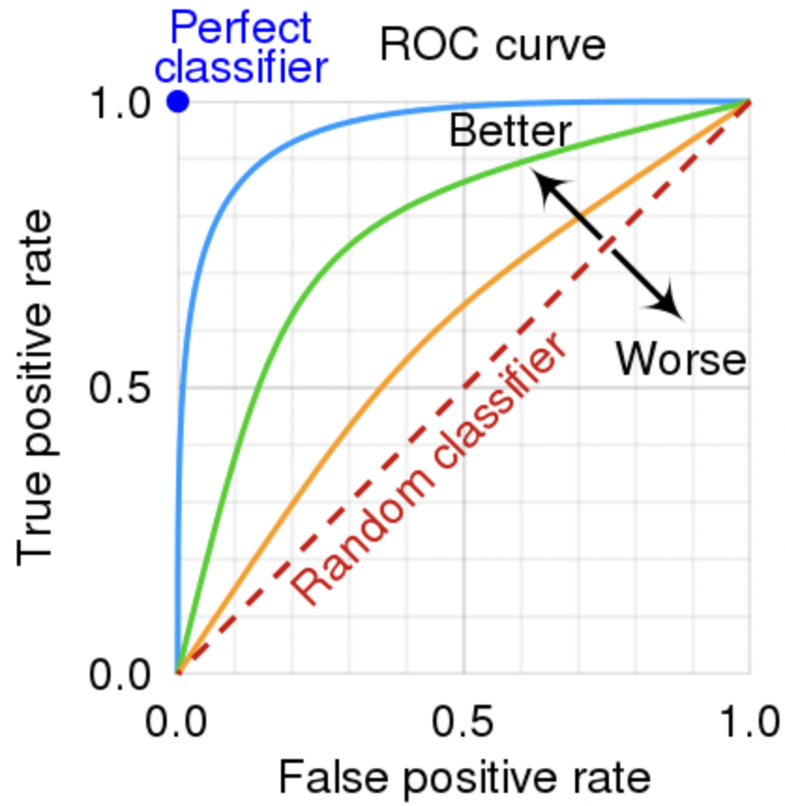
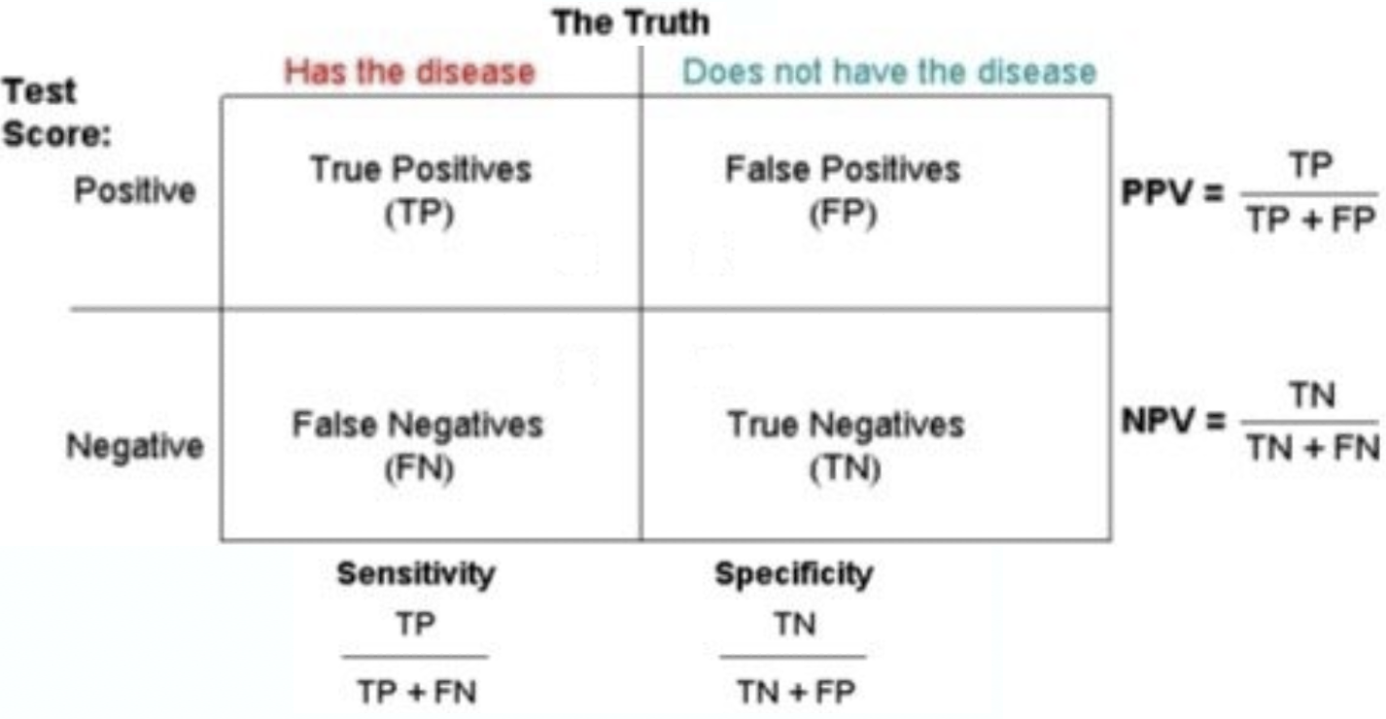
Logistic Regression
A probability threshold (c) used to classify data as Ŷ =1 if π̂ > c and Ŷ = 0 if π̂ ≤ c.
Notes:
Confusion matrix is a tabular representation of observed vs predicted data, and used to quantify the accuracy of the model.

Slide 24
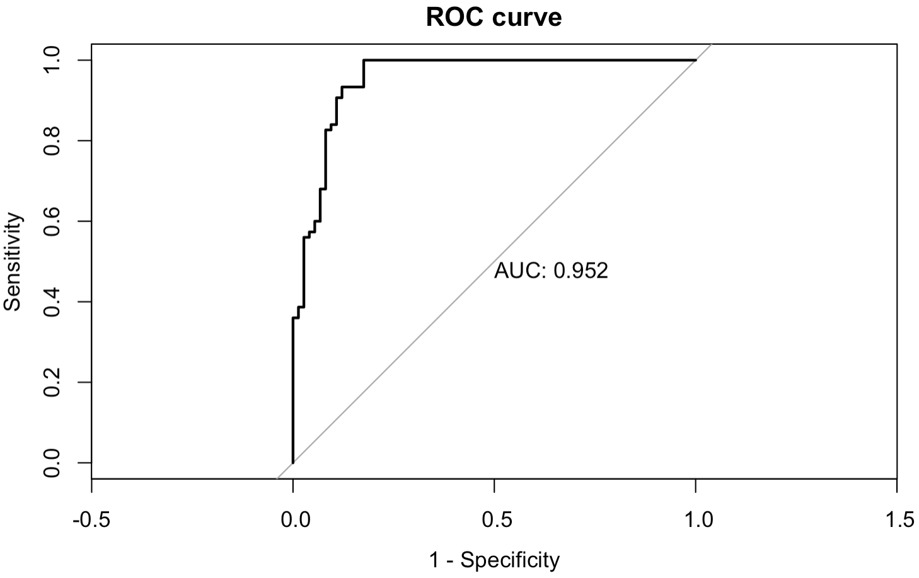
Logistic Regression
Fitting Lmodel0 with all variable (glm(formula = happy ~ . , data = Ld2021, family = binomial) returns multiple variables not significant. AIC = 89.4376
Again, the backward stepwise selection applied,
AIC_{(Lmodel1)} = 87.55, AIC_{(Lmodel2)} = 85.76, AIC_{(Lmodel3)} = 84.92, AIC_{(Lmodel4)} = 84.22
Notes:
Lmodel4 variables are all significant, and it have better results of AIC compared with Lmodel0.

Slide 25
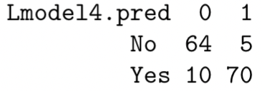

Logistic Regression
The final model (Lmodel4):
$$log\left(odds\right)=−44.3549+18.3826×Family+0.3361×Health + 8.4726×Freedom$$
Confusion matrix with probability threshold c = 0.5:
Accuracy = 0.8993
Sensitivity = 0.8649
Specificity = 0.9333

Slide 26
Discussion
Some problems and limitations in the model were that the normality hypotheses are rejected, the graph of residuals is a little curved, and happiness of a country could be affected by much more variables. If World Happiness Report team provided more detailed data, like the whole survey and the methodology of calculating the life expectancy, it will be possible to study the dataset deeper to get better model.
Classifying countries by Logistic Regression went great. Where it minimized AIC, all variables are significant, and have high scores for AUC, Accuracy, Sensitivity, and Specificity.
Collecting the data is just started recently (2015), in the future there will be larger dataset that will be enough to fit a better model that can predict the countries’ happiness for next years.
Notes:
This report went through analyzing the World Happiness Report dataset to understand it and to come out with a model that can predict the happiness score with high level of accuracy.

Slide 27
Thank you

